Slide 1
Programming with lists – part 2
An example involving prime numbers

Slide 2
A prime number (or prime integer, often simply called a "prime" for short) is a positive integer p>1 that has no positive integer divisors other than 1 and p itself. More concisely, a prime number p is a positive integer having exactly one positive divisor other than 1, meaning it is a number that cannot be factored.
http://mathworld.wolfram.com/PrimeNumber.html

Slide 3
fun isPrime n =
if n < 2 then false
else (* could be prime *)
let
fun aux k =
let
val r = n mod k
in
if k = n then true
else if r > 0 then aux (k+1)
else false
end
in
aux 2
end;
Note that the above solution does not focus on efficiency.

Slide 4
fun isPrime n =
if n < 2 then false
else
let
fun aux 1 = true
| aux k = if n mod k > 0 then aux (k-1)
else false
in
aux (n-1)
end;

Slide 5
fun isFactorOf (k,n) = n mod k = 0;
fun isPrime n =
if n < 2 then false
else
let
fun aux 1 = true
| aux k = if isFactorOf(k,n) then false
else aux (k-1)
in
aux (n-1)
end;
We would like to validate this function by running some tests.
Non-exhaustive testing is not a proof technique.
Tests perform checks that are necessary but not sufficient for correctness.
Software is not continuous.
Tests cannot reveal the absence of bugs, only their presence.

Slide 6
Positive testing
fun isPrime n = …
fun validateIsPrime [] = true
| validateIsPrime (x::xs) = isPrime x
andalso
validateIsPrime xs;
validateIsPrime
[ 2, 3, 5, 7, 11, 13, 17, 19, 23, 29, 31, 37, 41, 43, 47,
53, 59, 61, 67, 71, 73, 79, 83, 89, 97,101,103,107,109,113,
127,131,137,139,149,151,157,163,167,173,179,181,191,193,197,
199,211,223,227,229,233,239,241,251,257,263,269,271,277 ] ;
https://primes.utm.edu/lists/small/1000.txt

Slide 7
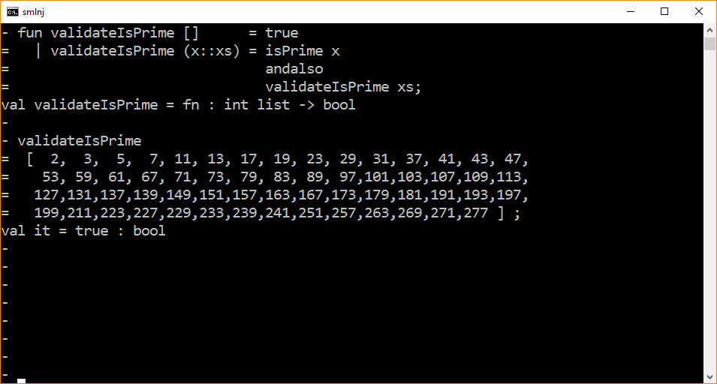

Slide 8
Negative testing
fun isPrime n = …
fun validateNonPrime [] = true
| validateNonPrime (x::xs) = not (isPrime x)
andalso
validateNonPrime xs;
How do we generate a large list of consecutive non-primes (composite numbers) given a large list of consecutive primes?

Slide 9
Generating test sets
How do we generate a large list of consecutive non-primes given a large list of consecutive primes?
Idea
Generate a list of consecutive integers in the range 0…max where max is the largest number in our prime number list.
From this generated list, filter out the numbers in our prime number list.
What remains are non-prime numbers.
Caveat: The testing-specific code you write must be correct or it, in turn, must also be tested.

Slide 10
fun maxOf [x] = x
| maxOf (x::xs) =
let
val max = maxOf xs
in
if x < max then max else x
end;
maxOf [1,5,2,3,8,6,9,4];
fun maxOf [x] = x
| maxOf (x::xs) = if x < maxOf xs then maxOf xs
else x;
The second solution has exponential running time!

Slide 11
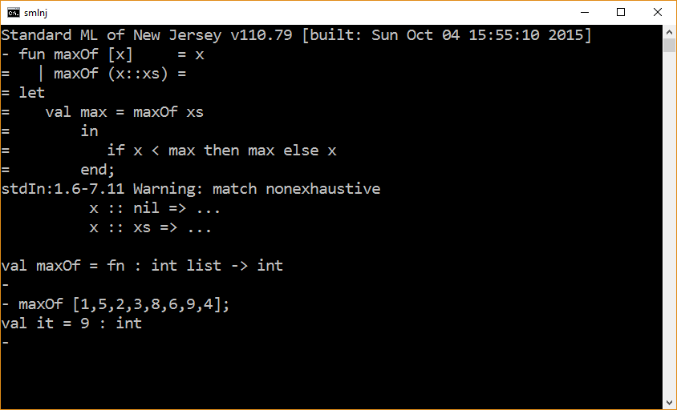

Slide 12
fun generate 0 = []
| generate n = generate (n-1) @ [n];
fun generate 0 = []
| generate n = n :: generate (n-1);

Slide 13
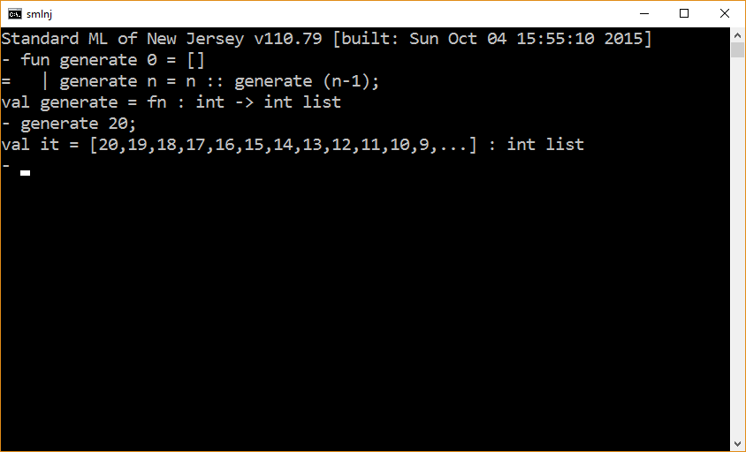

Slide 14
(* assumes the elements in the list are unique *)
fun remove (_,[]) = []
| remove (x, y::ys) = if x = y then ys
else y :: remove (x,ys);
(* induction on the length of the first list *)
fun filter ([], ys) = ys
| filter (x::xs, ys) =
let
val ysWithoutX = remove(x,ys)
in
filter(xs, ysWithoutX)
end;
filter([1,2,3],[1,4,2,6,3,7]);

Slide 15
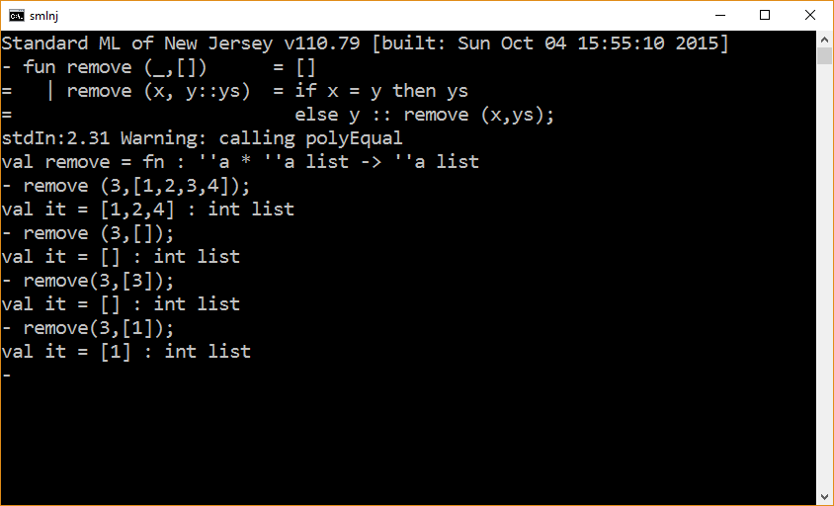

Slide 16
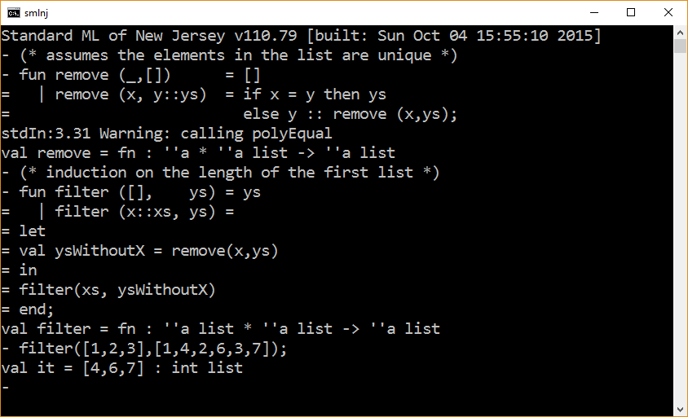

Slide 17
fun maxOf [x] = x
| maxOf (x::xs) =
let
val max = maxOf xs
in
if x < max then max else x
end;
fun generate 0 = []
| generate n = n :: generate (n-1);
fun remove (_,[]) = []
| remove (x, y::ys) = if x = y then ys
else y :: remove (x,ys);
fun filter ([], ys) = ys
| filter (x::xs, ys) =
let
val ysWithoutX = remove(x,ys)
in
filter(xs, ysWithoutX)
end;

Slide 18
(* assume input is a list of consecutive primes
beginning with 2. *)
fun test primes =
let
val maxPrime = maxOf primes;
val integerList = generate maxPrime;
val nonPrimeList = filter (primes, integerList);
in
validateNonPrime nonPrimeList
end;

Slide 19
The end

